Slide 1


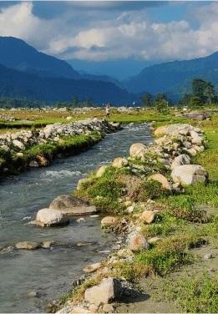




Impact of Image Resolution and Class Complexity on QCNN Performance
2nd Intelligent Computing and Technology Conference (ICTCon)
at
Central Institute of Technology Kokrajhar, Assam, India
2024
#107
Ashmit Sharma and
Shitala Prasad
Presented By:
Ashmit Sharma
Shri G.S. Institute of Technology and Science
Notes:
Good afternoon, everyone. My name is Ashmit Sharma, I am a final-year B.Tech student at Shri G. S. Institute of Technology and Science, Indore. Today, I am delighted to present our research on the 'Impact of Image Resolution and Class Complexity on QCNN Performance,' The paper is co-authored with Dr. Shitala Prasad sir from IIT Goa, who was also my guide throughout the research.

Slide 2
AGENDA
ashmitsharma630@gmail.com
2nd ICTCon at
CIT Kokrajhar, Assam
1. Why QCNNs
2. The Case for QCNNs
3. QCNN Architecture
Exploring the limitations of classical CNNs and the advantages of quantum computing in addressing scalability and efficiency challenges.
Highlighting the unique features and potential of Quantum Convolutional Neural Networks.
Overview of the model's design
4. Motivation and Aim
5. Methodology
6. Results, Insights and Conclusion
Inspiration behind the research and its overarching objectives.
Datasets, preprocessing steps, and experimental setup.
Performance evaluation, key findings, research contributions and future scope.
Notes:
So, Here’s an overview of what I will cover today. We will begin with why QCNNs are promising, then a detail on their architecture, followed by the motivation and aim of our research. I will then talk about the methodologies used and then the results obtained. Finally, I will conclude with insights and potential future directions.

Slide 3
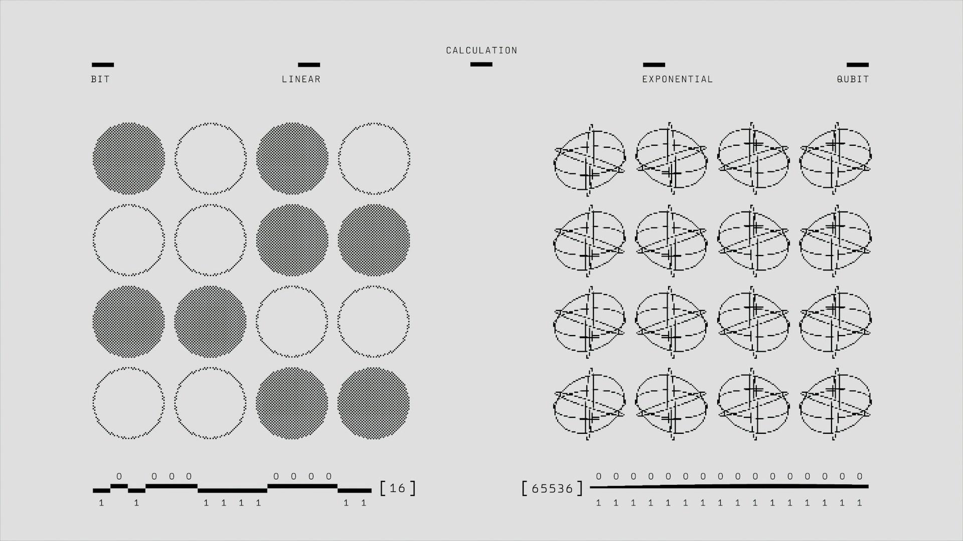
WHY QUANTUM CONVOLUTIONAL NEURAL NETWORKS?
2nd ICTCon at
CIT Kokrajhar, Assam
ashmitsharma630@gmail.com
Growing demand for faster, more efficient machine learning models.
Classical CNNs face limitations: High computational needs, large dataset requirements.
Quantum computing: A promising solution to enhance efficiency and scalability.
Source: Unsplash (Google DeepMind)
Notes:
Okay. Many of you might ask. Why QCNNs when we already have CNNs which are the State of the Art models for most of the computer vision tasks? Well, imagine a future where machine learning models not only process data faster but also require fewer resources. Quantum Convolutional Neural Networks, or QCNNs, bring us closer to this reality by leveraging quantum computing principles to overcome the limitations of classical CNNs.
I agree that CNNs have revolutionized computer vision, but they rely on large datasets for training and require high computational resources which restricts their scalability and real time usage.
QCNNs, on the other hand, promise exponential improvements by using quantum bits or qubits, which can process data more efficiently through superposition and entanglement.
On the left hand side you can see a comparison of classical bits and qubits and understand why qubits are so much superior. You see, in the classical domain we only have 1 state per bit and thus 16 bits can only represent 16 states. However, when we transition to the quantum domain, each qubit can be used to represent multiple states simultaneously (2 to the power of n to be precise, where n is the number of qubits) and thus 16 qubits can represent 65536 states. Giving us a glimpse of the possibilities they entail.

Slide 4
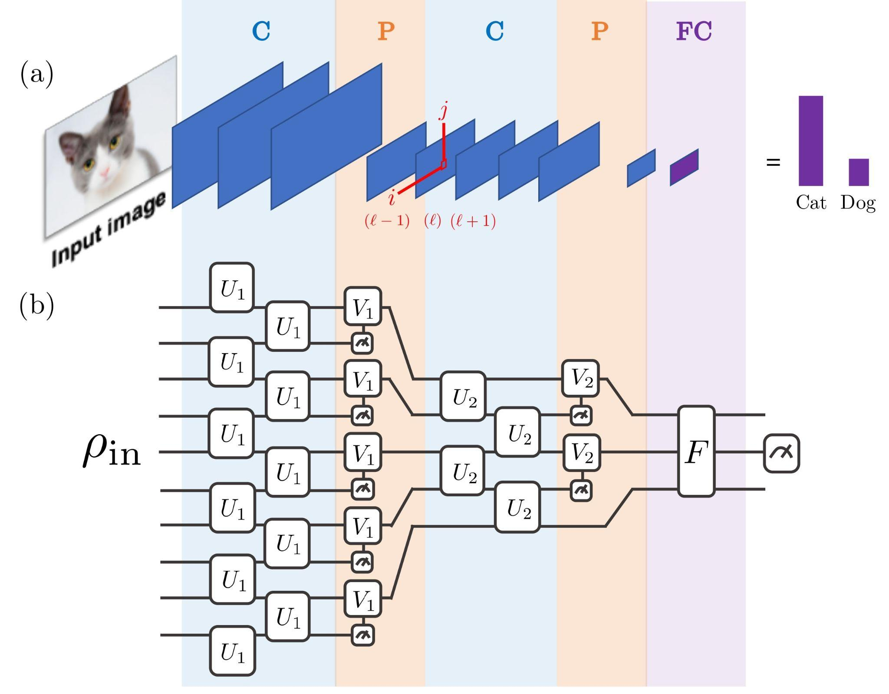
THE CASE FOR QCNNs
2nd ICTCon at
CIT Kokrajhar, Assam
ashmitsharma630@gmail.com
QCNNs mimic CNN structures but operate in the quantum domain.
They leverage qubits to reduce resource needs and enhance generalization.
Superposition: Qubits process multiple states simultaneously.
Entanglement: Capture complex relationships between data features
Parallelism: Process multiple computations simultaneously, reducing resource needs.
Source: Cong, I., Choi, S., Lukin, M.D.: Quantum convolutional neural networks. Nature Physics 15(12), 1273–1278 (Aug 2019).
Notes:
So, what makes QCNNs unique? QCNNs are actually very similar in structure to the classical CNNs. Both of them have a convolution, pooling and fully connected layers. But the difference lies in how these layers are constructed. QCNNs operate in the quantum domain. Instead of classical bits, they use qubits, as discussed.
Leveraging quantum domain also allows QCNNs to take advantage of entanglement and parallelism which further helps them in capturing more complex features and process data faster.

Slide 5
LAYERS
(CONVOLUTION)
2nd ICTCon at
CIT Kokrajhar, Assam
ashmitsharma630@gmail.com
Convolution operation on on a 5x5 input image using a 3x3 kernel, resulting in a 3x3 output image. The operation is performed with a stride of 1 and no padding.
Source: Github - aqeelanwar
Notes:
This animation shows how the convolution operation takes place. How a 3x3 kernel convolves over a 5x5 input image and produces the output by performing element-wise multiplication and summation.

Slide 6
LAYERS
(POOLING)
2nd ICTCon at
CIT Kokrajhar, Assam
ashmitsharma630@gmail.com
Source: Medium Article - Introduction To Pooling Layers In CNN
Notes:
And, this animation shows how pooling operation takes place. Now pooling can be done in many ways. One of the ways is max pooling represented on the left side and another is average pooling on the right side. In pooling a kernel passes through the input image and based on the type of pooling, produces the output. Incase of max pooling, it takes the highest value from the area covered by the kernel and in average pooling it takes the average.

Slide 7
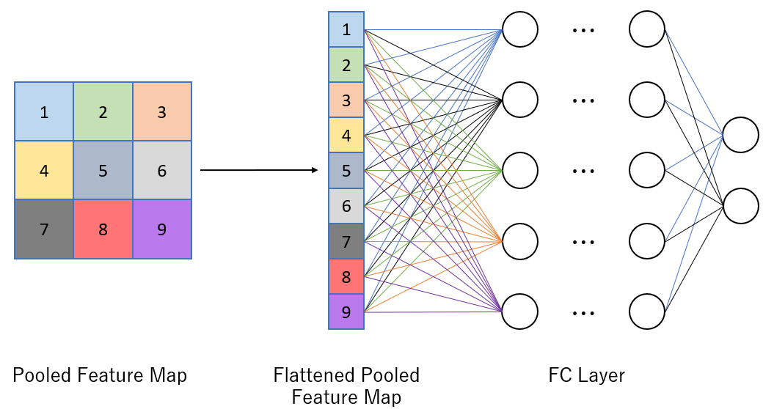
LAYERS
(FULLY CONNECTED)
2nd ICTCon at
CIT Kokrajhar, Assam
ashmitsharma630@gmail.com
The pooled feature map is flattened into a 1D vector and passed through fully connected layers to combine features and classify the input into categories.
Source: Medium Article - Convolutional Neural Networks (CNNs) : A Complete Guide
Notes:
Finally, the pooled feature map is flattened and passed on to the fully connected layers where the features are combined and classified into different categories.

Slide 8
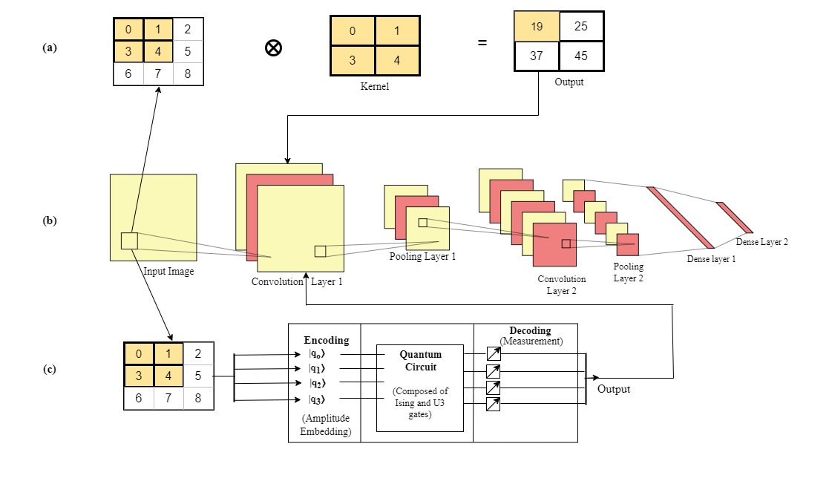
QCNN ARCHITECTURE
2nd ICTCon at
CIT Kokrajhar, Assam
ashmitsharma630@gmail.com
(a) Classical Convolution:
A 2x2 kernel slides over a 3x3 input matrix.
Element-wise multiplication and summation produce a 2x2 output.
(b) CNN Architecture:
Layers: Convolution → Pooling → Dense layers.
Used for feature extraction and classification.
(c) QCNN Convolution:
Input is encoded into quantum states.
Quantum circuit processes data using gates (e.g., Ising, U3).
Measurement decodes the output.
QCNN Layers:
All layers are composed of similar quantum variational circuits.
Notes:
Now as I said, the difference between CNNs and QCNNs lies in how we construct these layers. In QCNNs we use quantum variational circuits to build these layers. For example the figure shows how convolution is happening in CNN and QCNN. Let us focus on the QCNN for the moment. The input image is first encoded to convert it to quantum bits, then passed through a quantum circuit made of different types of quantum gates like the I3 and Ising gate. The qubits are then measured and then the output is fed to the next layer having a similar structure but different organization of gates.

Slide 9
MOTIVATION AND AIM
ashmitsharma630@gmail.com
2nd ICTCon at
CIT Kokrajhar, Assam
Motivation
Overcoming CNN limitations in real-world applications (e.g., resource-constrained environments).
Potential for QCNN to address AI challenges like small data availability and computational efficiency.
Aim
To evaluate simulated QCNN’s performance on datasets with differing image resolutions and class complexities.
Compare simulated QCNN’s effectiveness to CNN in terms of accuracy and scalability.
Notes:
Now, though Classical CNNs are still State-of-the-art models for most of the computer vision tasks, they struggle in resource-constrained environments and when using smaller datasets. QCNNs can address these challenges with their computational efficiency.
So by this research we have tried to make an effort to simulate the QCNN models using pennylane framework and evaluate the simulated model’s performace on different datasets with varying resolution and class complexity and compare their accuracies to CNN when using fewer number of training samples.

Slide 10
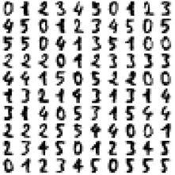
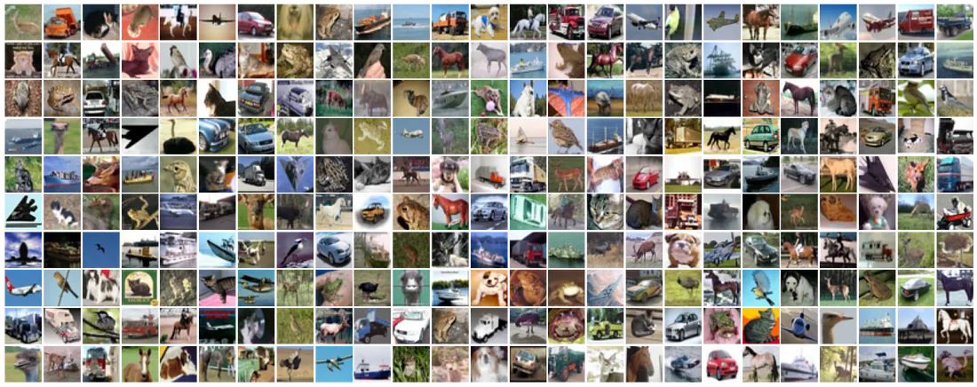
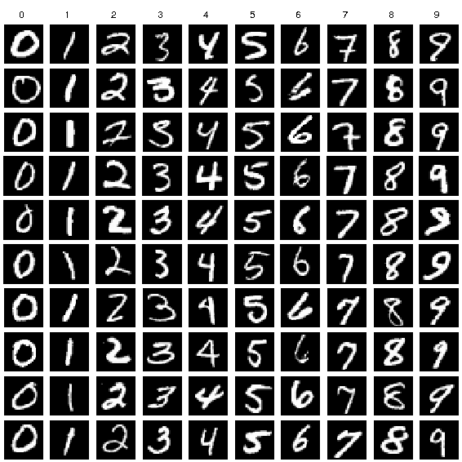
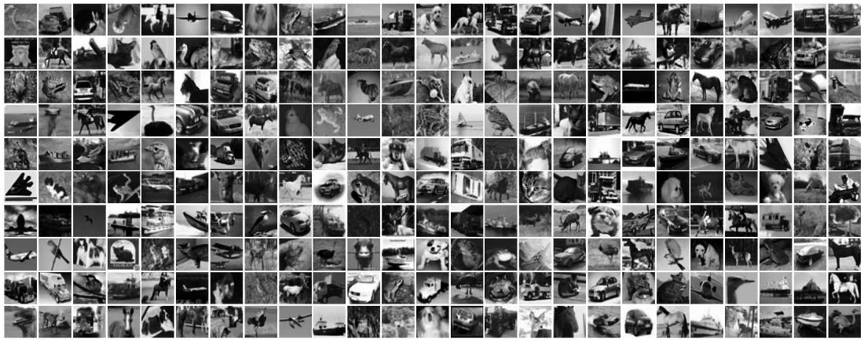
METHODOLOGY
(DATASETS USED)
2nd ICTCon at
CIT Kokrajhar, Assam
ashmitsharma630@gmail.com
(a) scikit-learn digits dataset
(c) CIFAR-10 Dataset (Colored)
(b) MNIST dataset
(c) CIFAR-10 Dataset (Grayscaled)
Notes:
The datasets used in the study were scikit-learn’s digits datasets which consists of 8x8 images of handwritten digits. MNIST dataset which is also handwritten digits but with a higher resolution of 28x28 and CIFAR-10 dataset which is a more complex dataset containing images of birds, animals, vehicles etc. and is having a dimension of 32x32.

Slide 11
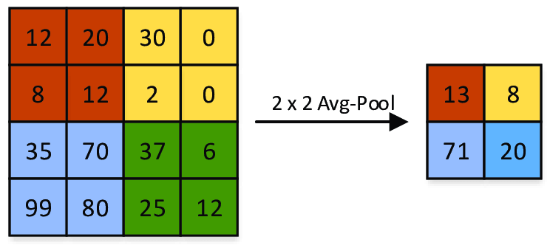
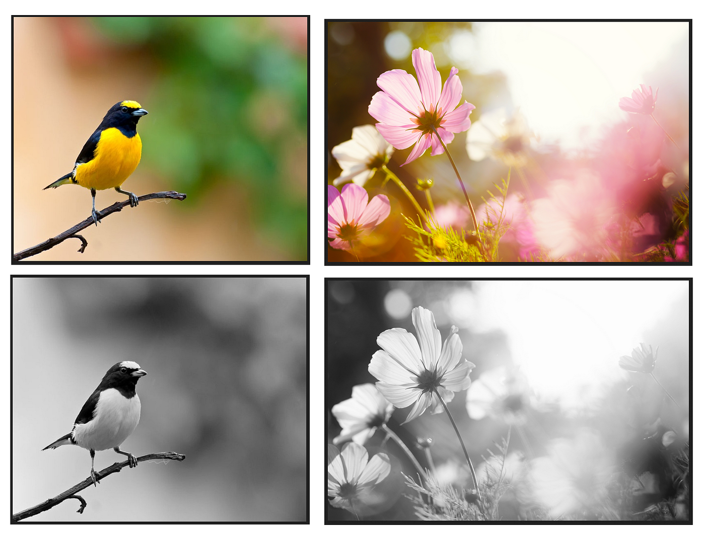
METHODOLOGY
(PREPROCESSING)
ashmitsharma630@gmail.com
2nd ICTCon at
CIT Kokrajhar, Assam
DOWNSIZING
GRAYSCALING
Images resized to 8×8 pixels using average pooling.
CIFAR-10 color images converted to grayscale.
Source: Dominguez-Morales, Juan Pedro. (2018). Neuromorphic audio processing through real-time embedded spiking neural networks.
Source: Medium Article - Convert a Color Image to GrayScale in Python
Notes:
However, mind you that to maintain uniformity. In some cases, the datasets were resized to 8x8 using average pooling and CIFAR-10 was resized as well as grayscaled in some cases.

Slide 12

EXPERIMENTAL RESULTS
ashmitsharma630@gmail.com
2nd ICTCon at
CIT Kokrajhar, Assam
ICTCon
2024
Ashmit Sharma (SGSITS, Indore)
Notes:
Now, moving on to the experimental results,

Slide 13
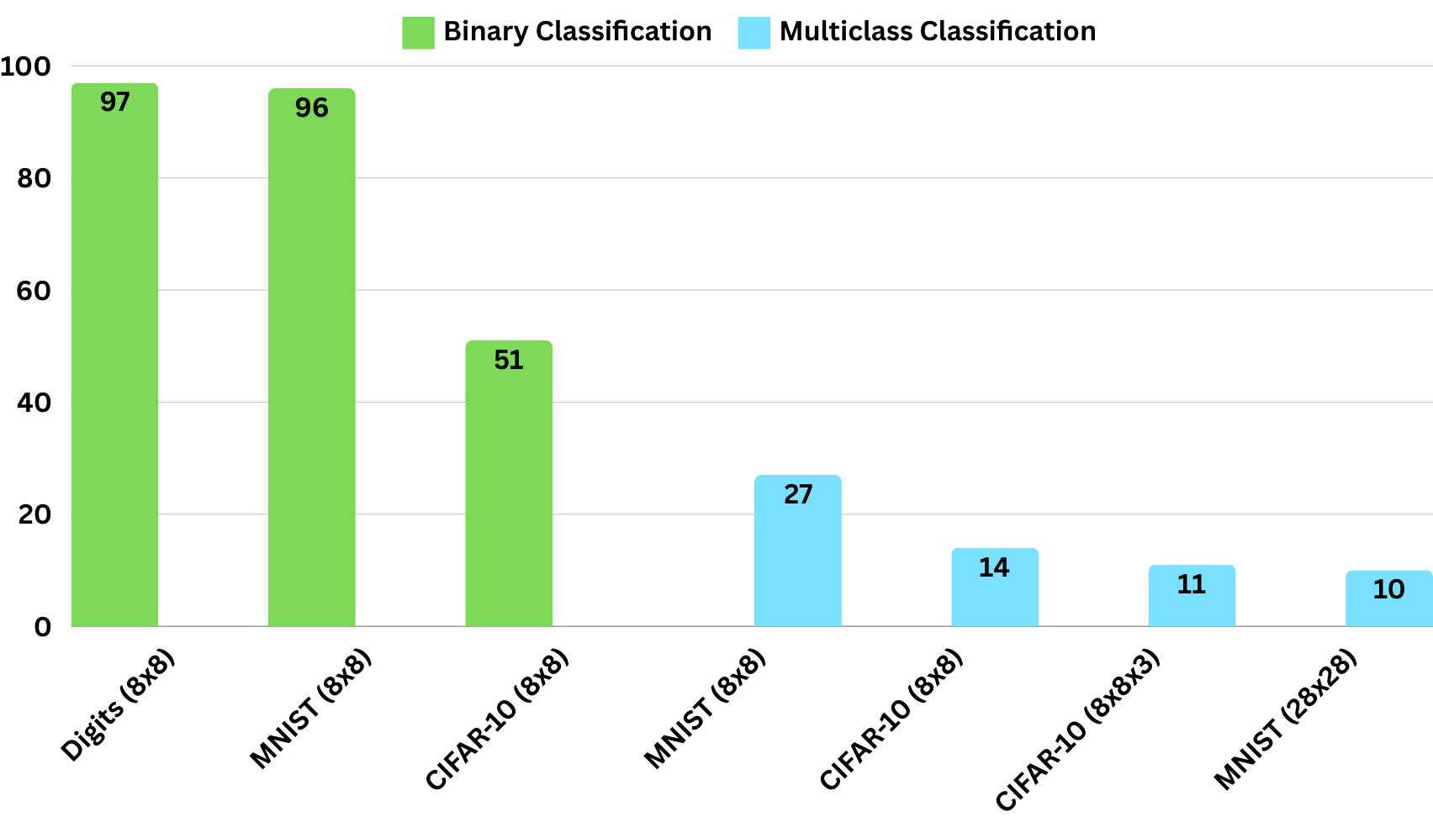
RESULTS
2nd ICTCon at
CIT Kokrajhar, Assam
ashmitsharma630@gmail.com
Notes:
This graph summarizes our results. When we tested it on the simplest tasks like binary classification of lower resolution images. The simulated QCNN performed at a testing accuracy of 97% and 96% in the case of both the handwritten datasets with just 80 training samples. However with a slight increase in complexity the accuracies dropped to 51% in case of CIFAR-10 grascaled and downsized dataset. When increasing the complexity of the task at hand further, i.e by classifying into 10 classes rather than 2, the accuracy dropped sharply. As you can see in the blue bars. The downsized MNIST where the model performed at 96%, now performed at just 27% even when the training samples used were increased to 4000, whereas the accuracy of the model on CIFAR-10 downsized and grayscaled dataset dropped from 51% to just 14%. Increasing the complexity of the task further we tried to test the model on full sized MNIST images as well as downsized but coloured CIFAR-10 and as you can see, the accuracies were still very low. Also the time required to train this model increased as the dimension of the image increased because the number of qubits required to encode the image increased.

Slide 14
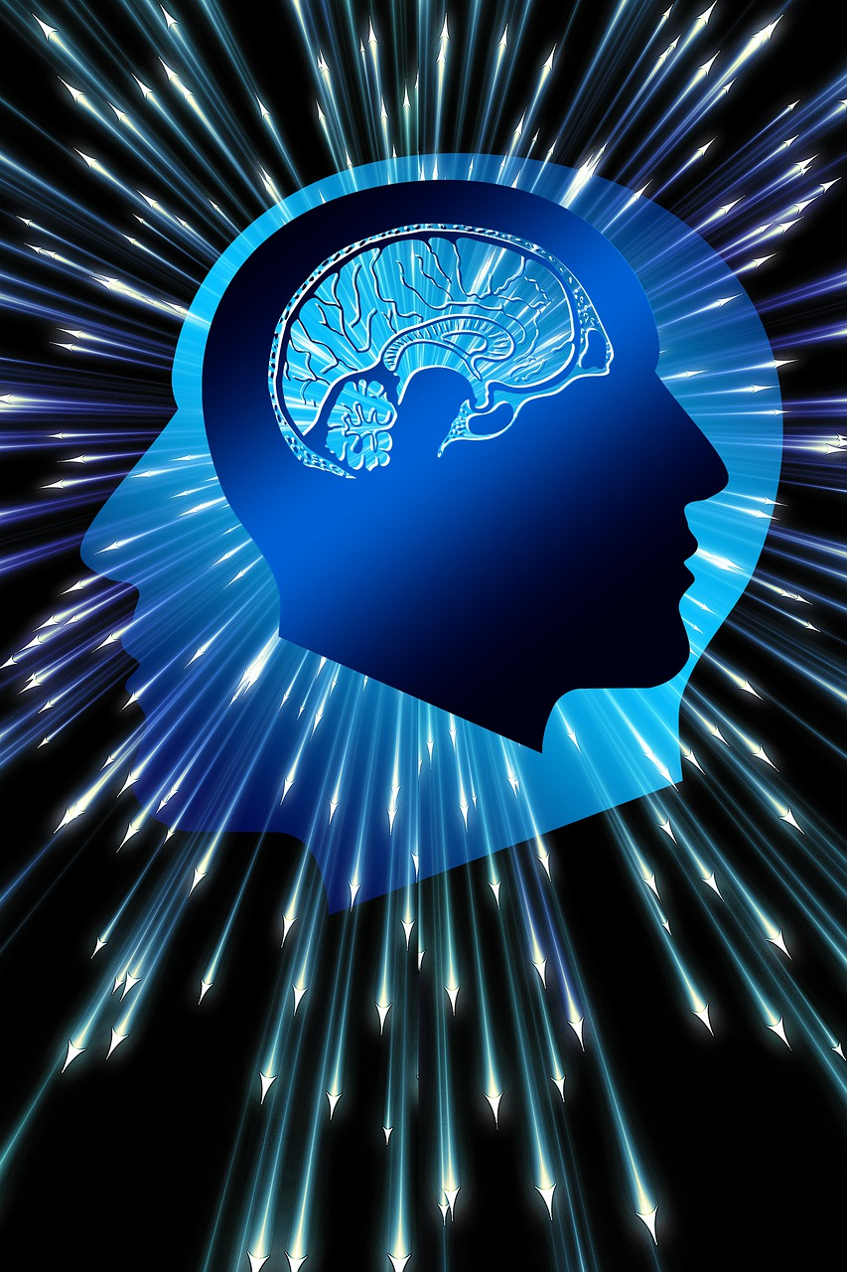
INSIGHTS
ashmitsharma630@gmail.com
2nd ICTCon at
CIT Kokrajhar, Assam
QCNNs excel in low-resolution, binary tasks.
Performance declines with higher complexity due to scalability challenges.
Highlights the importance of optimizing quantum architectures for broader tasks.
Notes:
The insights we gained through this research were that when simulating them, QCNNs excel in scenarios with low-resolution images and simple classification tasks. However,
Their performance is limited when dealing with high-resolution images or tasks with greater class diversity.

Slide 15
CONCLUSION
ashmitsharma630@gmail.com
2nd ICTCon at
CIT Kokrajhar, Assam
Demonstrated QCNN’s strengths in low-resolution and binary classification tasks.
Highlighted its potential for smaller datasets.
Future Scope:
Optimize QCNN architectures for higher resolution and class diversity.
Explore real-world applications, including quantum hardware integration.
Notes:
So, To sum it all up, our research demonstrates the strengths of QCNNs in specific applications, particularly for smaller datasets and less complex tasks in a simulated environment.
Since quantum hardware is still very expensive and difficult to obtain, the results obtained would be more concrete if we could analyze the behaviour of the model using actual hardware rather than using simulations.
In summary, QCNNs have the potential to significantly impact the field of machine learning, but achieving their capabilities will require continued exploration and enhancement.

Slide 16



THANK YOU
2nd Intelligent Computing and Technology Conference (ICTCon)
at
Central Institute of Technology Kokrajhar, Assam, India
Ashmit Sharma
ashmitsharma630@gmail.com
Dr. Shitala Prasad
shitala@iitgoa.ac.in

